Slide 1


HARDPOINT
HACKATHON
Group No 5
Anurag Chandra
Athul Menon P
Divya Devaraj
Gopika Babu
Gokul P

Slide 2
CONTENTS
Introduction
Problem Statement
Methodology
Challenges and Solutions
Results
Conclusion

Slide 3

INTRODUCTION
In this project, our aim is to develop a system that automates the extraction of title and author information from scientific documents while also generating alternative titles based on the content of each document. By analyzing the text of printouts, the system will identify the document's title and author(s) with precision. Additionally, it will leverage natural language processing techniques to propose alternative titles that encapsulate the main ideas presented in the document. This system holds significant promise for researchers, academic institutions, and publishers, as it promises to streamline document analysis processes, enhance information retrieval efficiency, and improve accessibility to scholarly content.

Slide 4
PROBLEM STATEMENT
The task is to develop a system capable of automatically extracting the title and author information from scientific documents and generating alternative titles based on the document content. The system should analyse the text of each document printout, identify the title and author(s), and then propose alternative titles that capture the essence of the document's content.

Slide 5
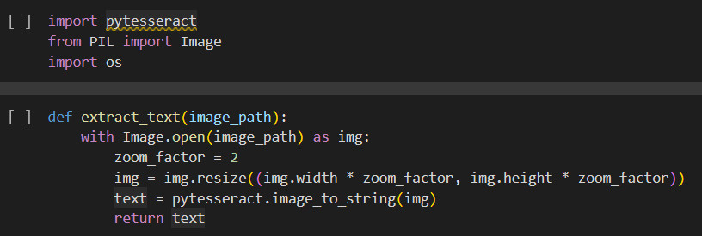
METHODOLOGY
Step 1:
Used Optical character recognition to parse images and save as text file.
Used Python library called pytesseract for this purpose.

Slide 6
METHODOLOGY
Step 2:
Used Huggingface pipelines and an inherit pipeline from Huggingface called NER(Named Entity Recogniton)to identify the name of a person from a text file.
Assumption taken is that the name(s) that appears in the beggining is that of the author.

Slide 7
METHODOLOGY
Step 3:
Used another pipeline called question-answering pipeline and give the first 200 characters of the text file as input and asked for the title.
It returned the title
Step 4:
Used another pipeline called text generation in order to generate a new title.

Slide 8
CHALLENGES AND
SOLUTIONS
1)Training an LLM model from scratch is a computationally heavy task.
2)Fine tuning a pre-trained model requires very heavy datasets and provided dataset was small. Hence to overcome this problem, pipelines were used.
3)Due to the usage limits in colab, we couldn't generate the data as sheets format.

Slide 9
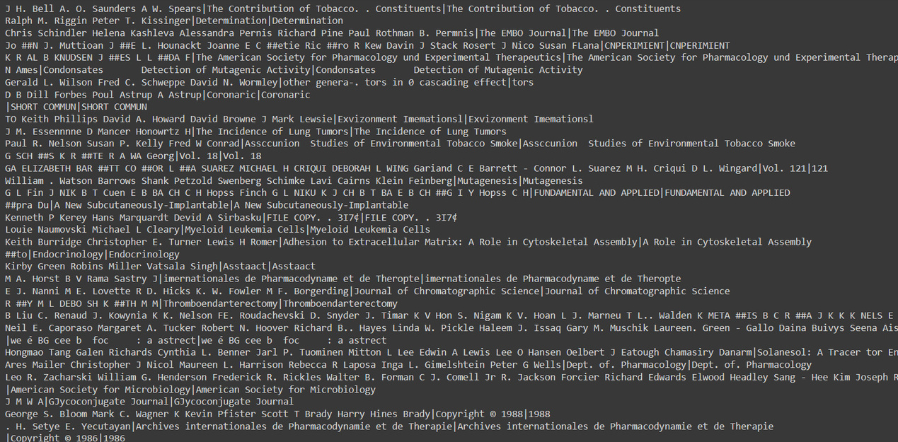
RESULT
The output was achieved but not on google sheets due to its usage limit.
The source code is present in the following github link.
https://github.com/Anuragchandra221/Hackathon-24
If the images are not visible, please visit the above link.

Slide 10

The author and the title was extracted succesfully.
The new title was not generated as expected
CONCLUSION

